Slide 1
Math?
No calculus required – but some may be shown
Basic arithmetic, powers of ten, simple logarithms (e.g. log-log plots)
100 = 10² → log 100 = 2
if 5 = a log 100 then a = 5/ log 100 = 5/2 = 2.5
10⁹ / 10⁴ = 10⁹ 10⁻⁴ = 10⁹⁻⁴ = 10⁵ (≠ 10^{9/4} !!! )
10^{1/2} = 10^{0.5} = √10 = 3.162277669….
Some geometry and trigonometry (lots of triangles!), simple algebra, …

Slide 2
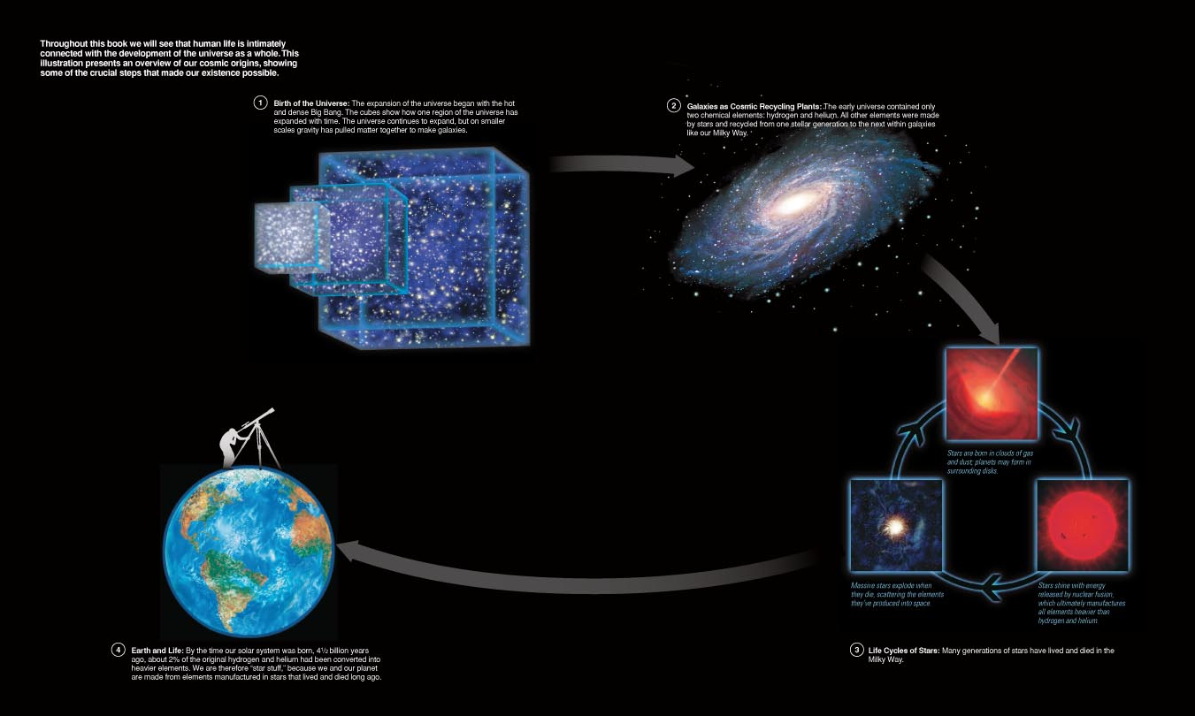
Summary of last lecture:

Slide 3
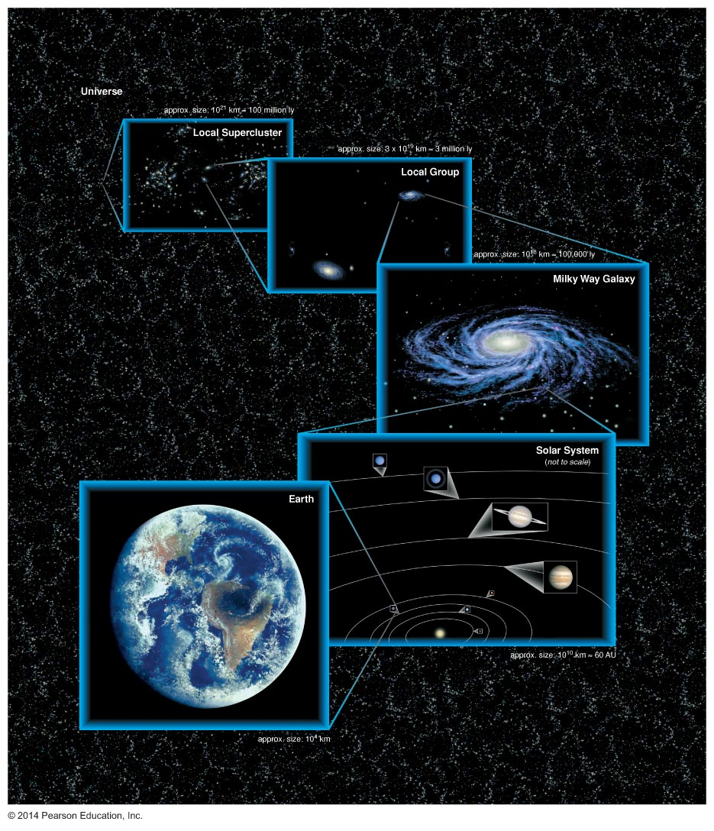
Summary of last lecture:

Slide 4
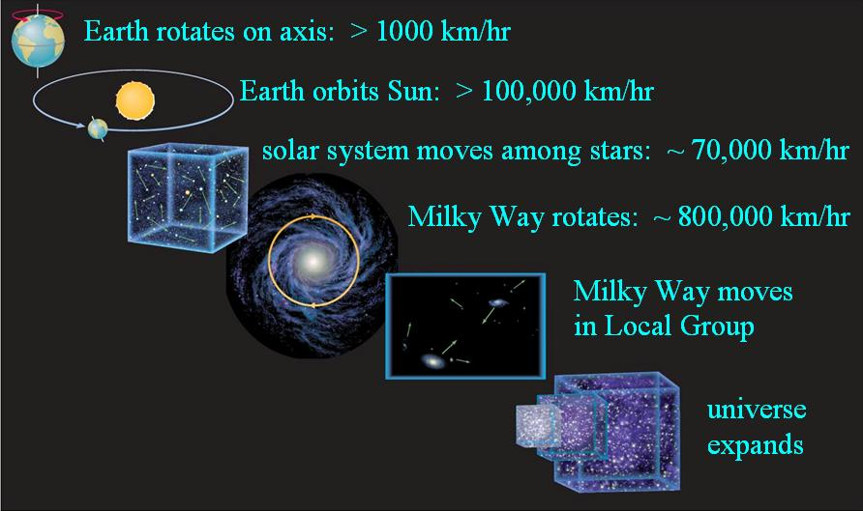
Summary of last lecture:

Slide 5
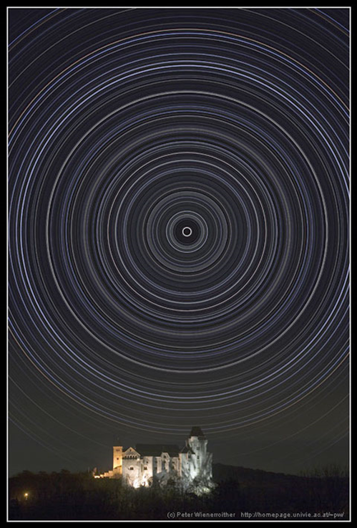
Where we’re at:
Cosmic Perspective
The Sky
Early Astronomy
Tools: Gravity and Light
Solar System
Stars
Galaxies
Cosmology
ET Life
star trails over Vienna

Slide 6
The Sky
Naked eye astronomy:
stars and constellations (88) / “asterisms”
rotation of the Earth and “sky coordinates”
phases of the moon
the ecliptic: path of the Sun & planets in the sky
seasons
time
Main point: Motions appear complex because
motions are not all circular
motions are not all in the same plane
we are on the Earth, spinning and moving

Slide 7
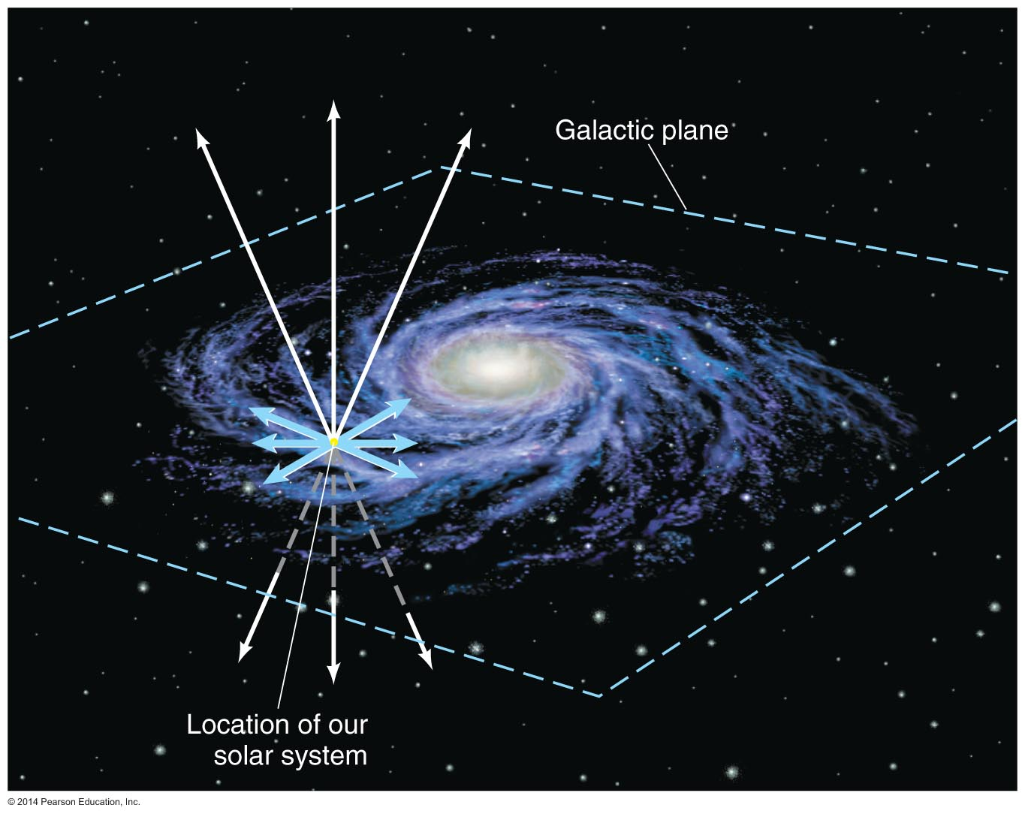
Big Picture

Slide 8
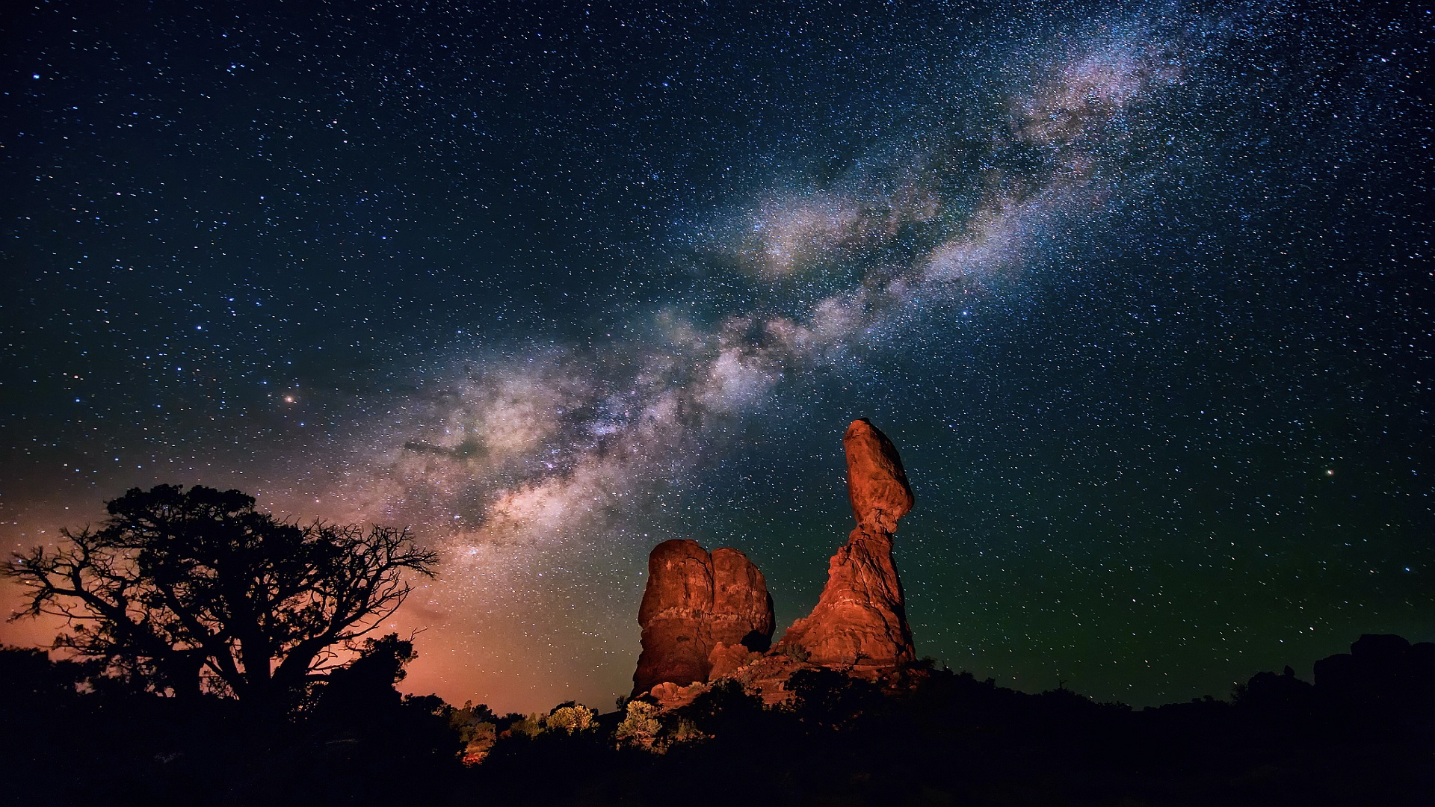
Big Picture

Slide 9
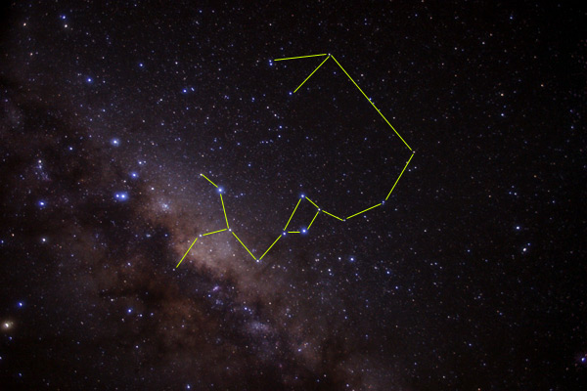
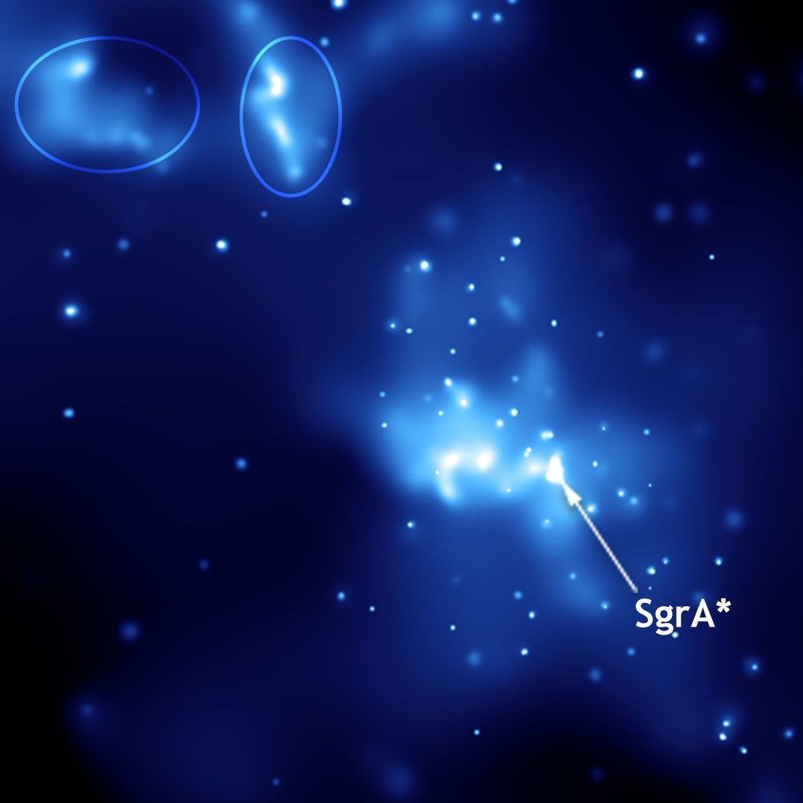
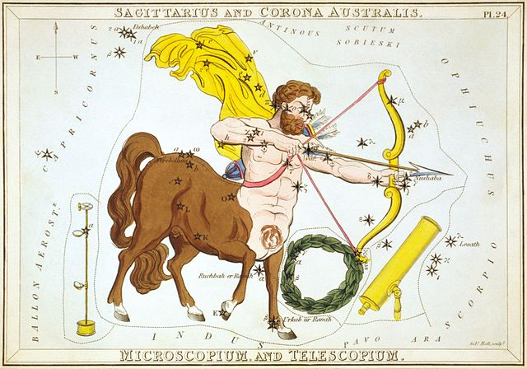
Stars and Constellations (Sagittarius)
…towards galactic centre (Sgr A*, bright compact radio source)

Slide 10
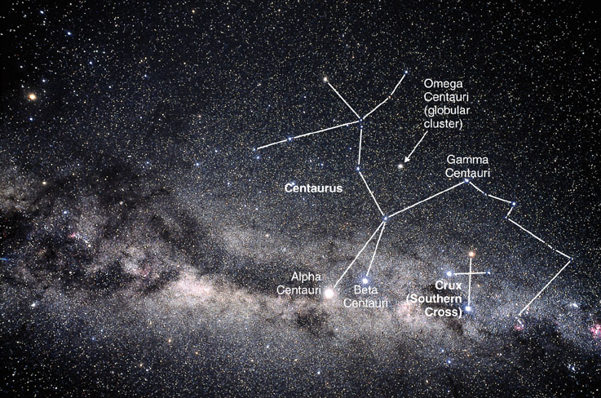
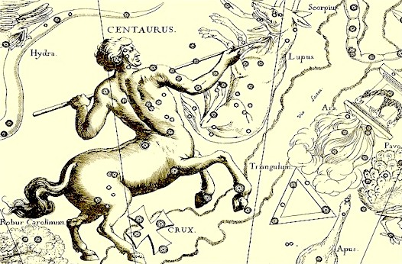
Stars and Constellations (Centaurus) …contains Alpha Centauri (closest star system: A, B, C; 4.4 ly)

Slide 11
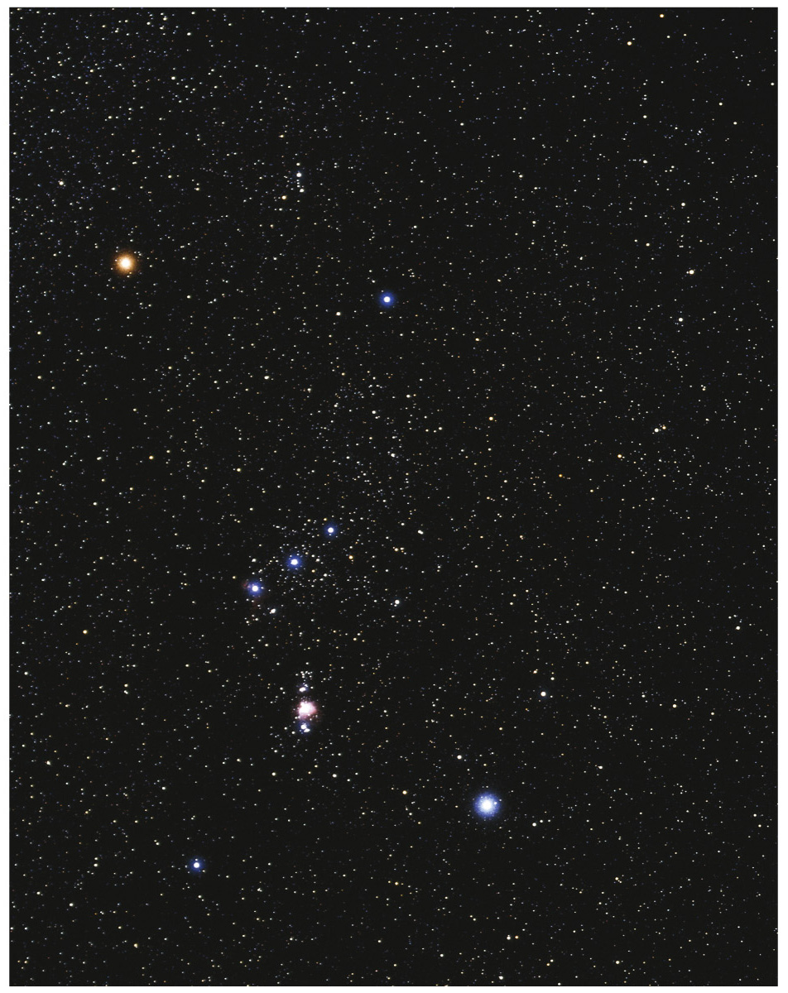
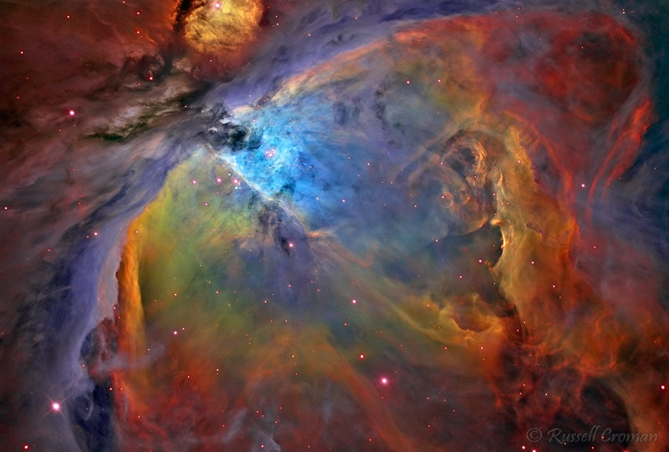
Stars and Constellations (Orion) striking pattern bright stars different colours gaseous nebula star clusters

Slide 12
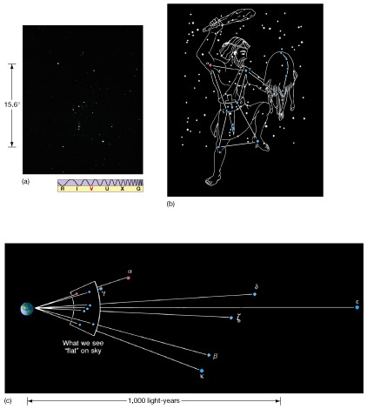
Stars and Constellations (Orion) striking pattern bright stars different colours gaseous nebula star clusters

Slide 13
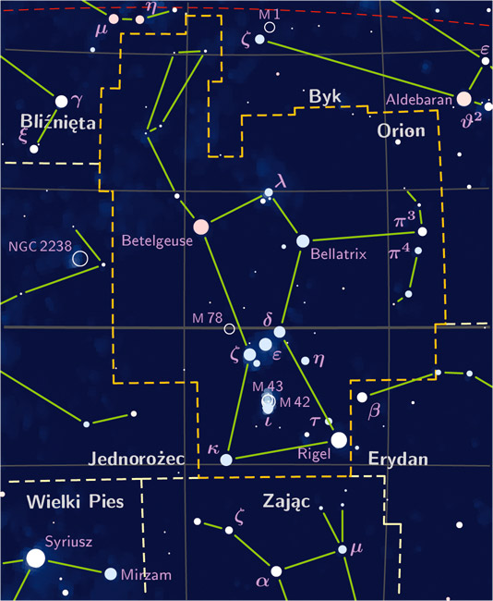
Stars and Constellations (Orion) striking pattern bright stars different colours gaseous nebula star clusters

Slide 14
Stars and Constellations (Orion)
the real picture

Slide 15
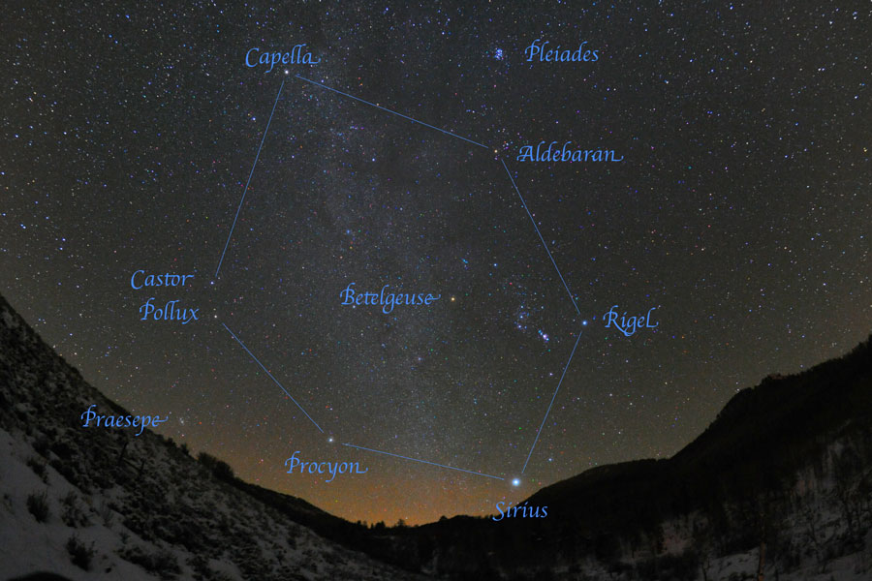
Stars and Constellations (Orion)
the Winter Hexagon

Slide 16
Motions in the Sky
daily rotation of the sky (of Earth, really!)
motion of the Moon and “phases”
motion of the Sun from one day to the next
hard to notice, because when the Sun is up you can’t see the stars; but the Sun is in a (slightly) different part of the sky (with respect to the stars) every day…how can you tell that this is true?
motion of planets

Slide 17
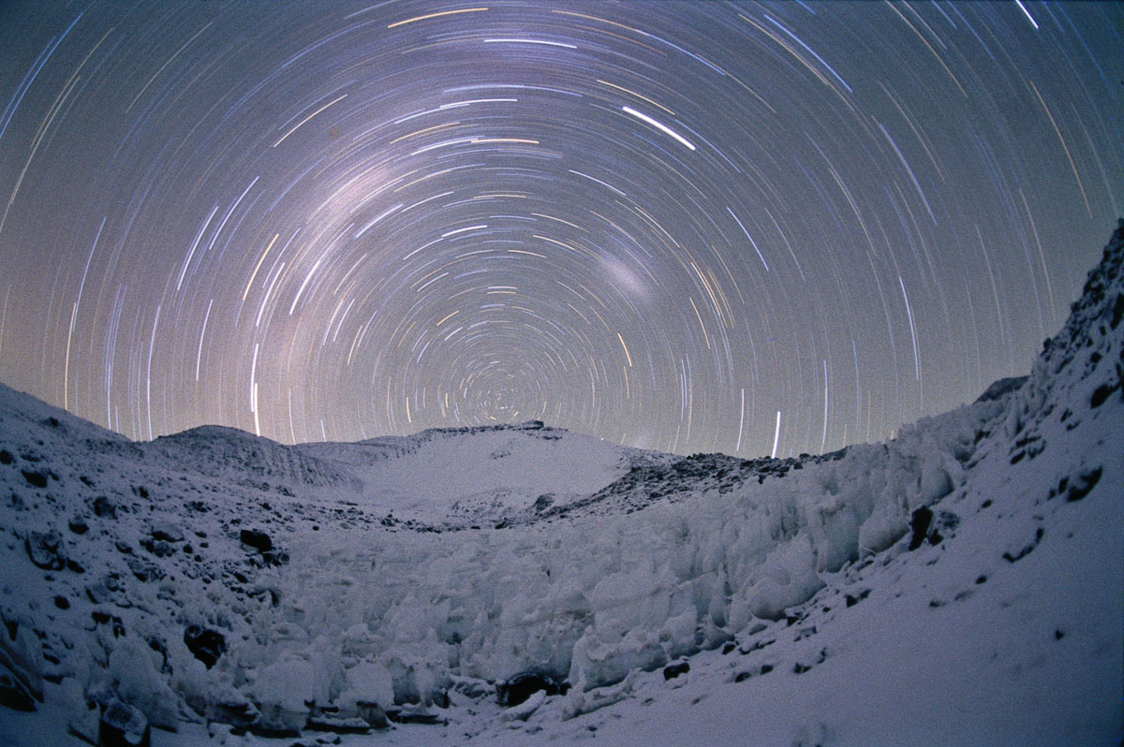
Stars move “around the sky”

Slide 18
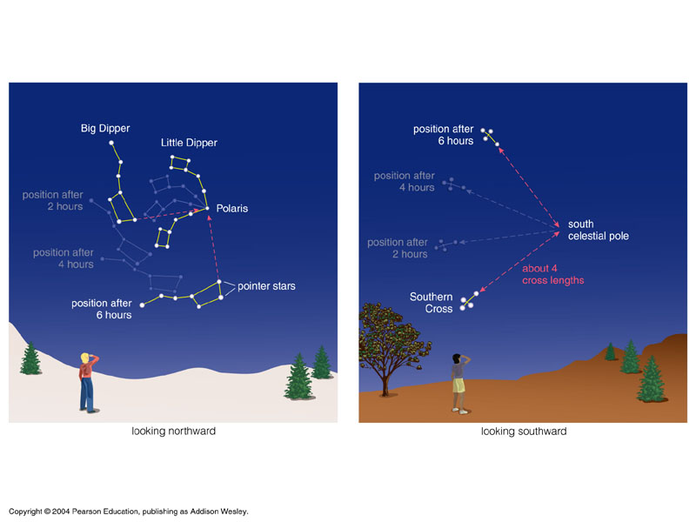
Rotation of the Earth…
…causes apparent rotation of the sky

Slide 19
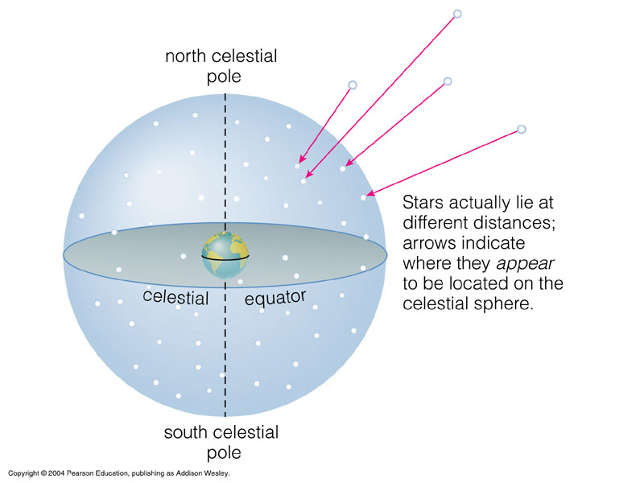
Stars appear to lie on a great
“celestial sphere” around the Earth

Slide 20
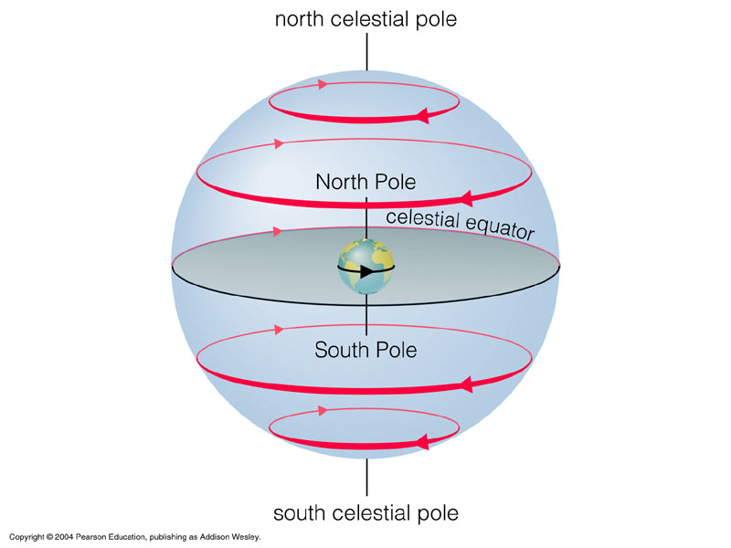
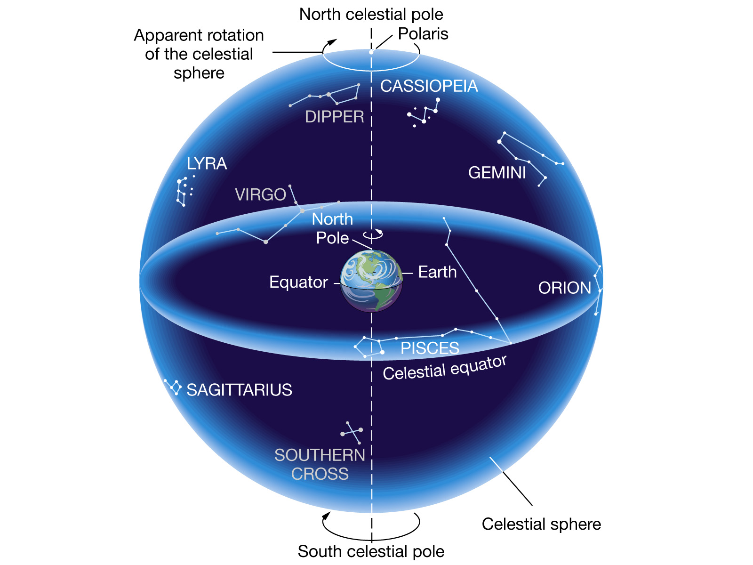
Earth’s rotation makes the celestial sphere appear to rotate about us (from E to W)

Slide 21
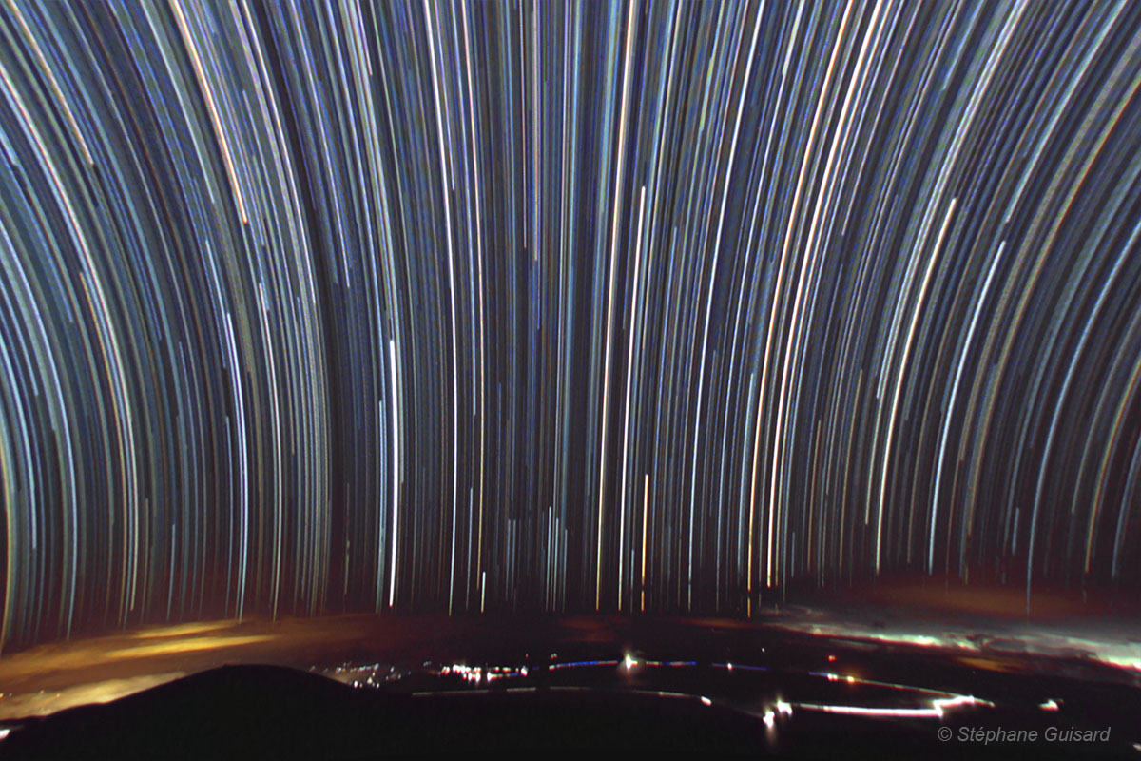
Sky rotation at the Equator
Stars near the celestial equator make almost straight lines.

Slide 22
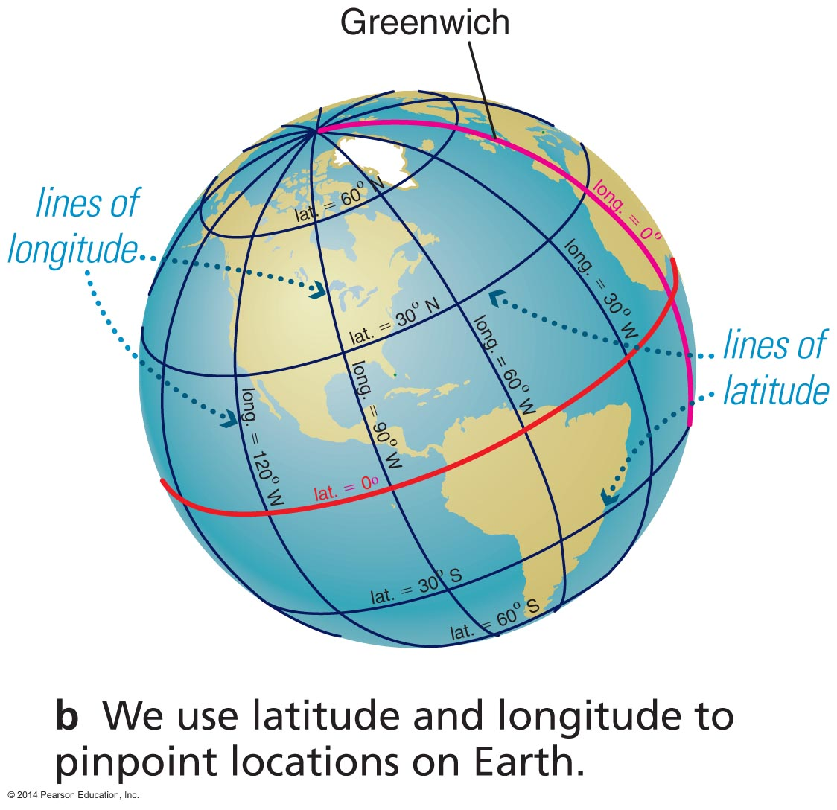
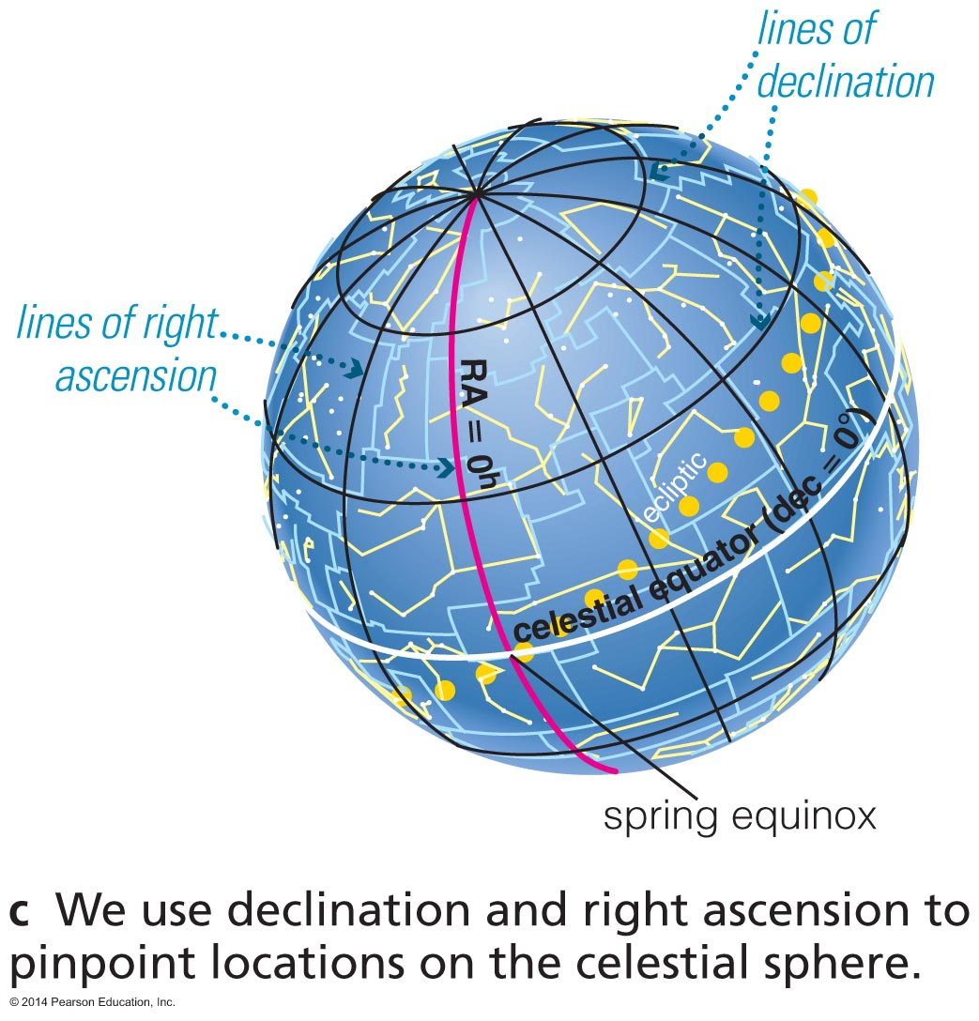
Location on the Sky
Right ascension: like longitude on celestial sphere (measured in hours with respect to spring equinox)
Declination: like latitude on celestial sphere (measured in degrees above celestial equator)

Slide 23
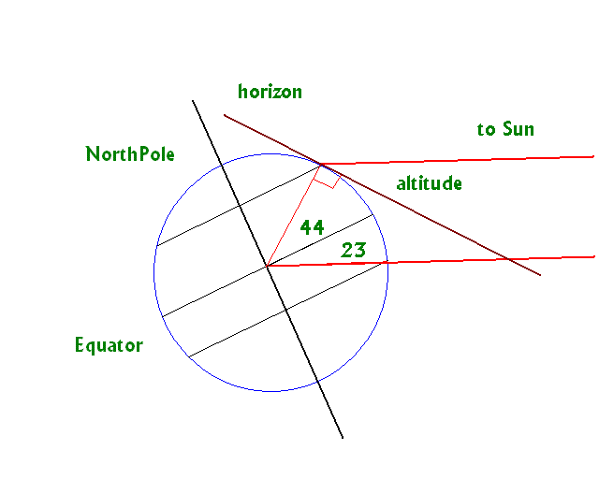
Example:
How high in “your” sky will an object be?
we are at a latitude of 44º. On 21 Dec the Sun is at a declination of -23.5º (would be seen directly overhead at noon at latitude of -23.5º).
how high in the sky
(altitude) is the Sun
at noon?
180 – (44 + 23.5 + 90)
= 22.5º

Slide 24
Separation of Objects on the Sky
Angular separation:
measured in degrees, (arc)minutes, (arc)seconds
1 degree = 60 arcmin = 3600 arcsec
…or… 1° = 60′ = 3600″
Often measured down to an precision of arcseconds
Notes:
Added for Winter 2011

Slide 25
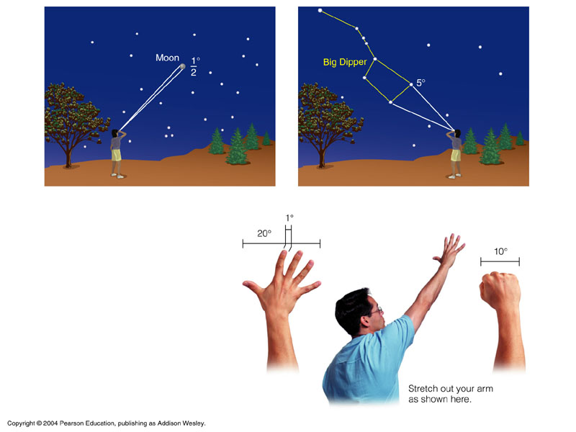
Question: What is the
approximate angular
diameter of the Sun?

Slide 26
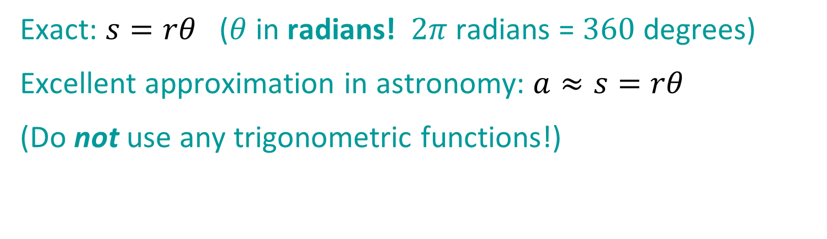
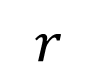
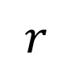
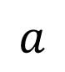
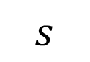
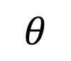
Separation of Objects on the Sky
Linear (or physical) separation, assuming the objects are at essentially the same distance from us:
$$r$$
$$a$$
$$s$$
$$θ$$
$$r$$
Exact: $s=rθ$ ($θ$ in radians! $2π$ radians = $360$ degrees)
Excellent approximation in astronomy: $a≈s=rθ$
(Do not use any trigonometric functions!)
Notes:
Added for Winter 2011

Slide 27
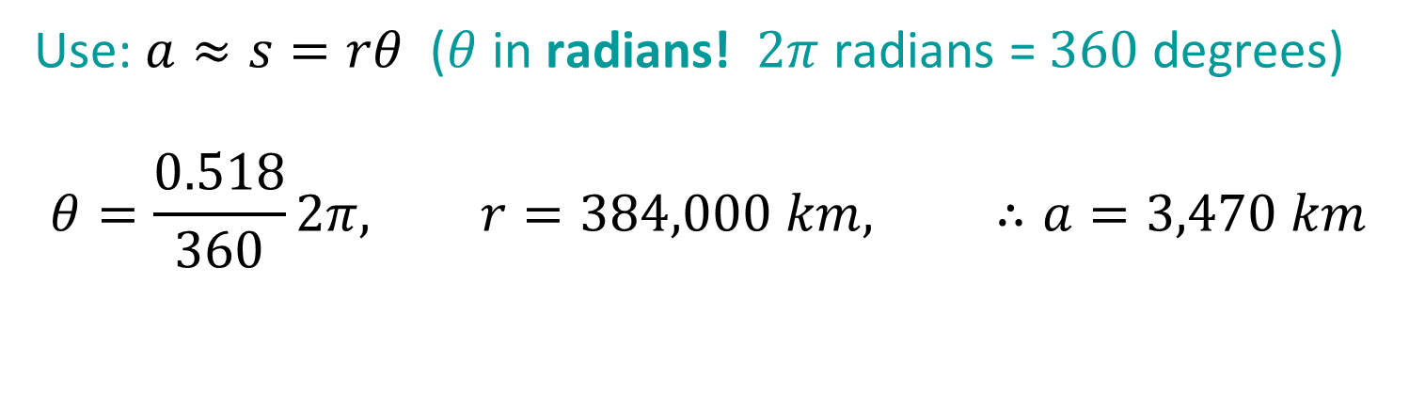
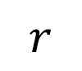
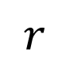
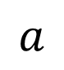
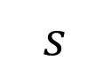
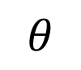
Separation of Objects on the Sky
Example
$$r$$
$$a$$
$$s$$
$$θ$$
$$r$$
Use: $a≈s=rθ$ ($θ$ in radians! $2π$ radians = $360$ degrees)
$$θ=\frac{0.518}{360}2π, r=384,000 km, ∴a=3,470 km$$
Notes:
Added for Winter 2011

Slide 28
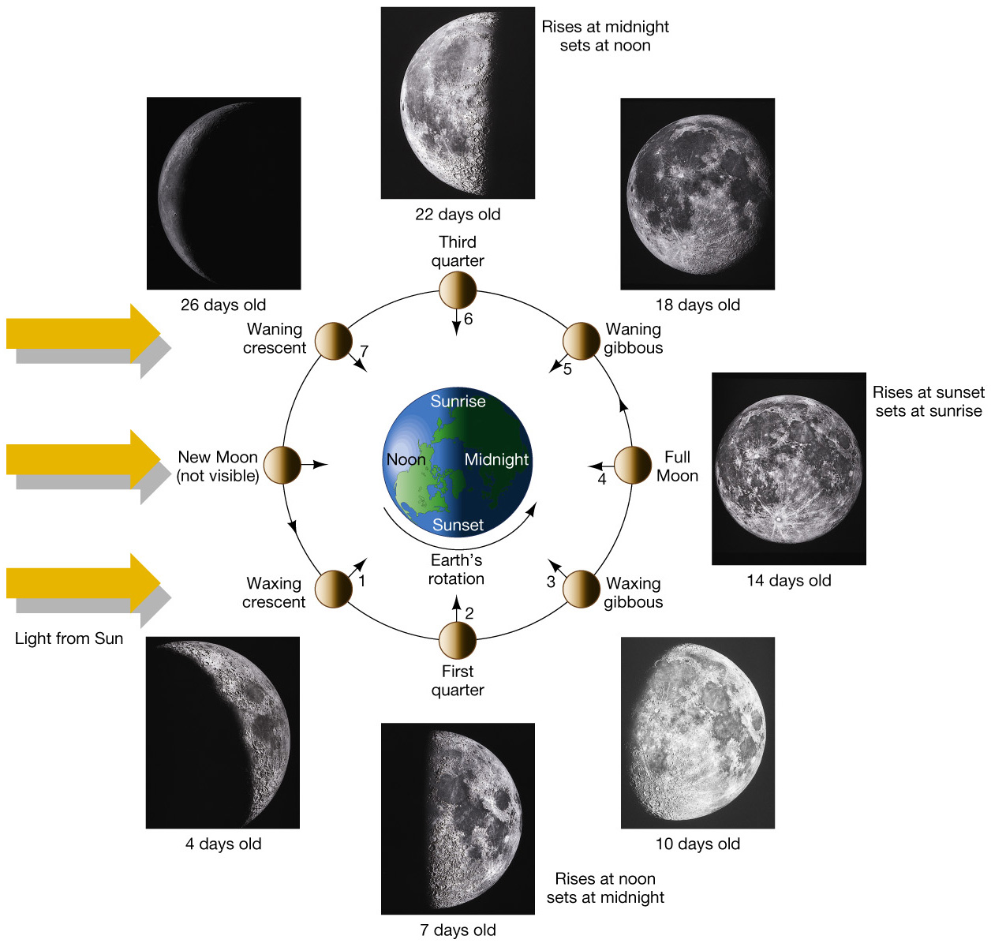
Moon &
its Phases
Notes:
Reached here on 6 Jan.

Slide 29
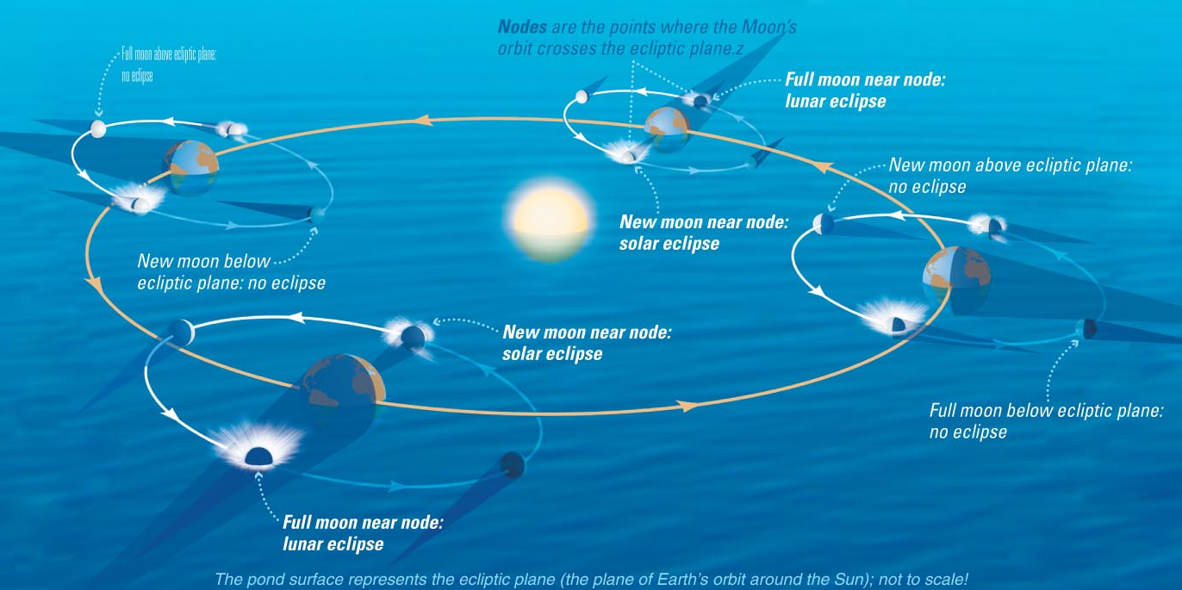
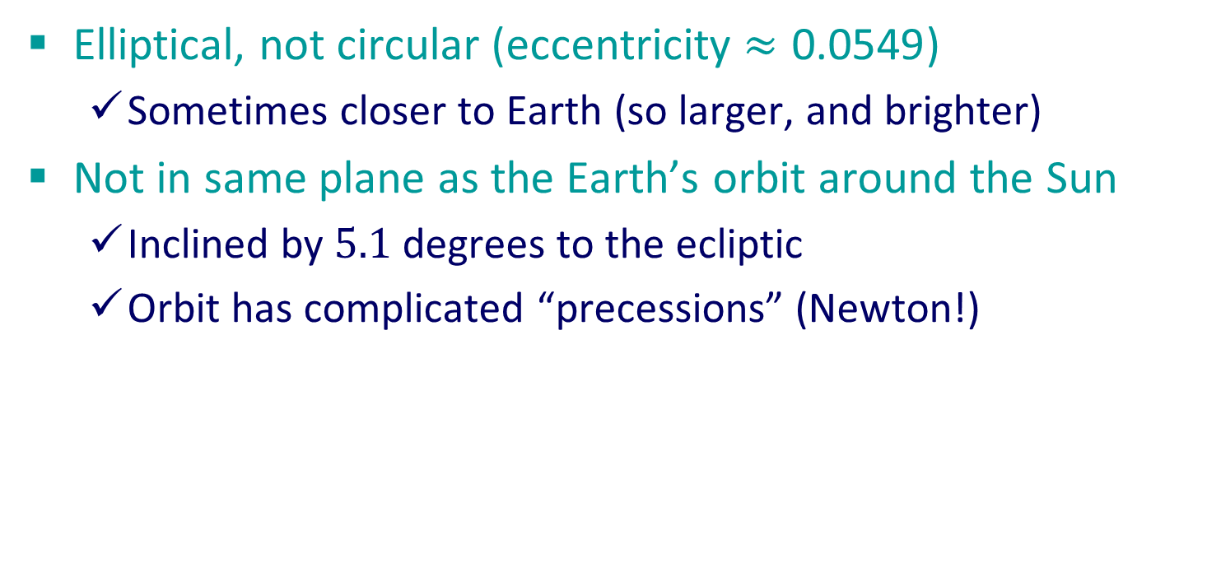
The Moon’s Orbit
Elliptical, not circular (eccentricity $≈\text{0.0549}$)
Sometimes closer to Earth (so larger, and brighter)
Not in same plane as the Earth’s orbit around the Sun
Inclined by $5.1$ degrees to the ecliptic
Orbit has complicated “precessions” (Newton!)
Notes:
Finished to here on 6 May

Slide 30
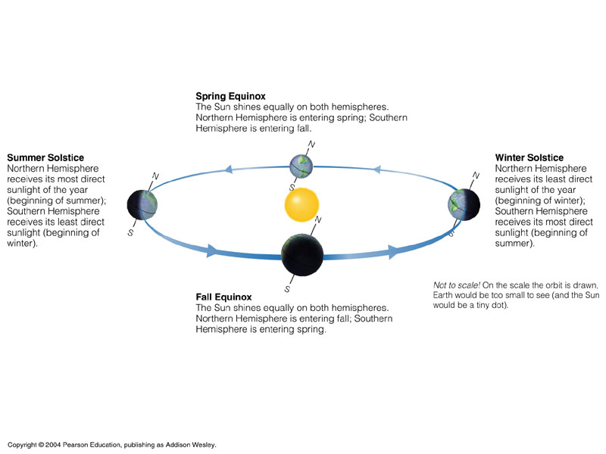
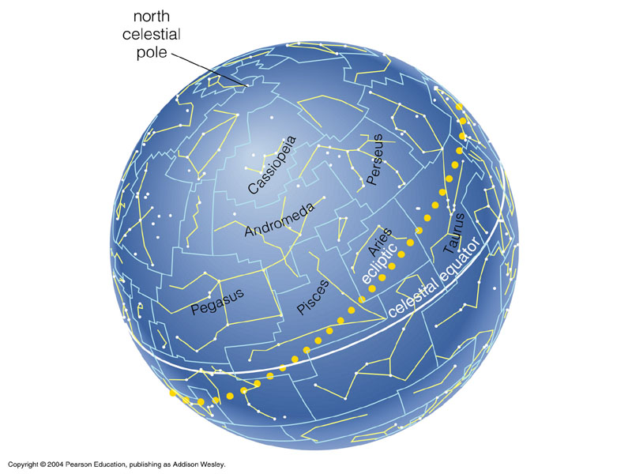
The Sun’s Changing Position in the Sky
Question: What is the tilt angle between the ecliptic and the equator planes?
Ecliptic = Sun’s path against background stars due to Earth’s motion around Sun.
Notes:
10/01/06 Remove this slide – next one is better and this is redundant

Slide 31
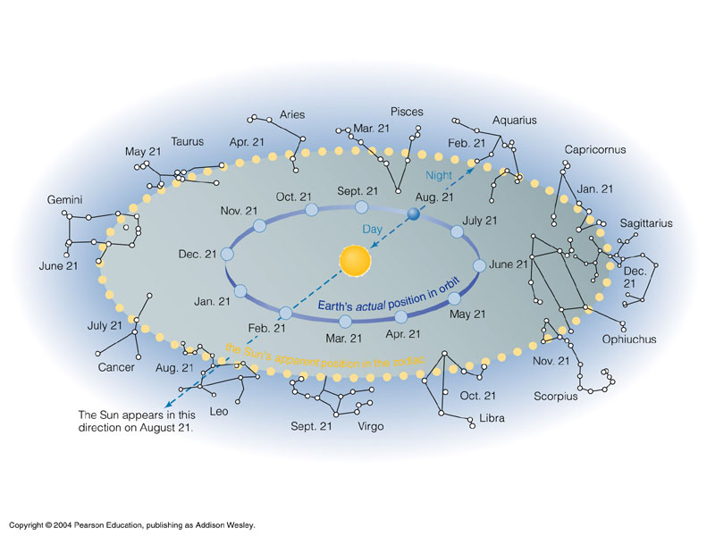
Sun’s path against the background stars is through the constellations of the “zodiac”

Slide 32
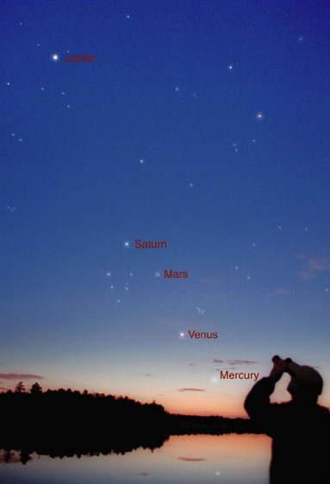
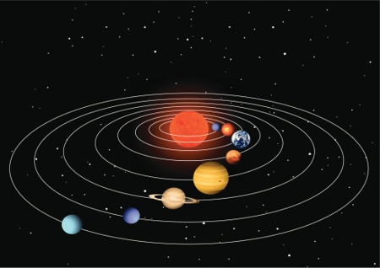
Paths of the Planets Across the Sky
Since all planets orbit the Sun in very nearly the same plane (the plane of Earth’s orbit), their paths against the background stars also lie roughly along the ecliptic.

Slide 33
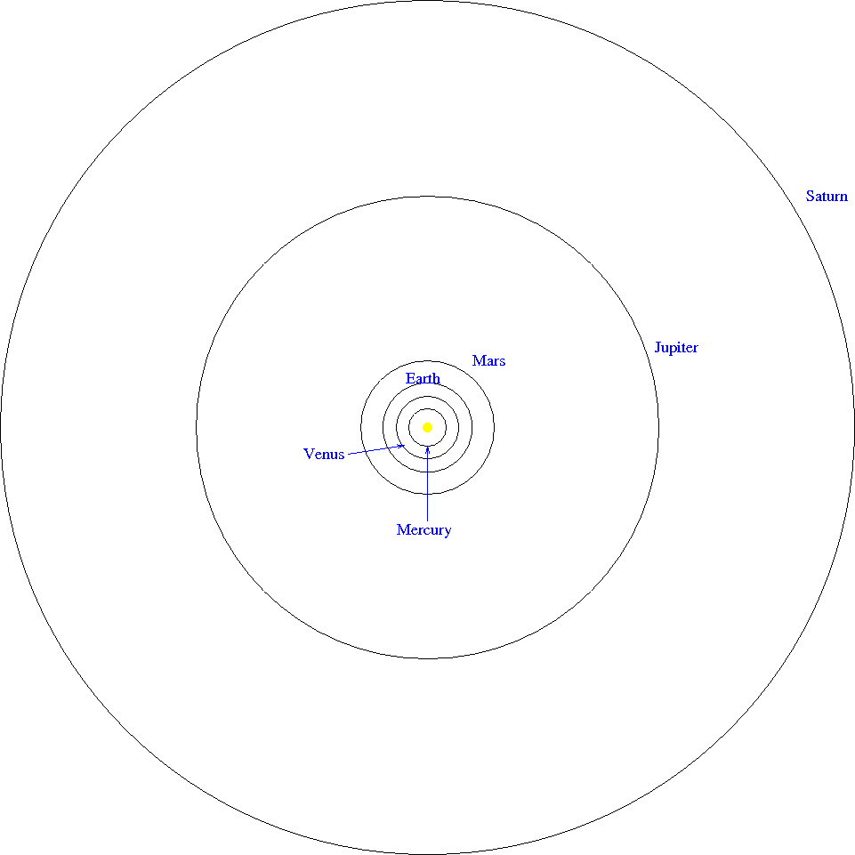
Planet orbits to correct scale
These are the “naked-eye” planets.
The planets themselves are too small to see on this scale, and the Sun is far too large in the figure.

Slide 34
The seasons are primarily caused by the tilt of Earth’s rotation axis to its orbital plane
Note: The Earth’s orbit is slightly elliptical. It is closest to the Sun at the beginning of January, and furthest at the beginning of July (difference of about 5 million km). Clearly, seasons have nothing to do with distance to the Sun!!!

Slide 35
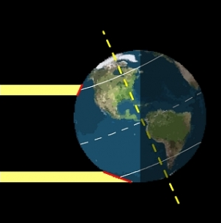
The seasons are primarily caused by the tilt of Earth’s rotation axis to its orbital plane
Note: The greater the tilt angle of the ground to the incoming sunlight, the greater area the Sun’s energy is spread over, and the less warming effect the Sun has. It’s (almost) all about the tilt angle!
Question: Are there other factors that affect the seasons?

Slide 36
More Subtle Topics
Time
Types of “day”, “month”, “year”
Apparent motion of the Sun: the “analemma”
Planetary periods
The Moon
Libration
Eclipses
Precession of the equinoxes

Slide 37
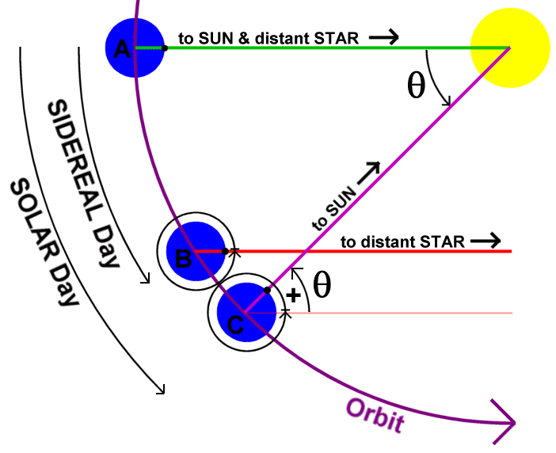
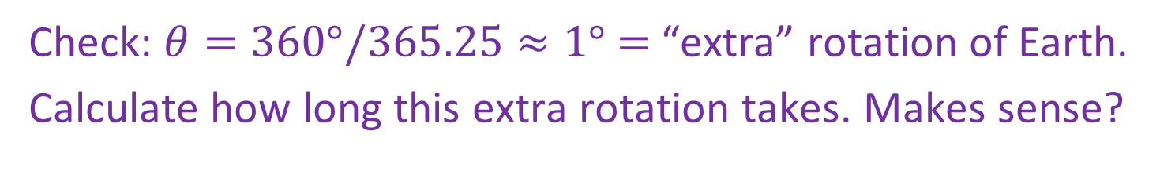
Types of “Day”
Sidereal Day
= Earth’s rotational per-iod relative to the stars
= 23^{h} 56^{m} 4.09^{s}
Solar Day
= Sun’s apparent rota-tional period (high noon to high noon)
= 24^{h}
Check: $θ=360°/365.25≈1°$ $=$ “extra” rotation of Earth.
Calculate how long this extra rotation takes. Makes sense?

Slide 38

The Sun’s Apparent Motion on the Sky
Notes:
got to herew (about to start this slide) at end of 8 Jan. 2008

Slide 39
Variations in Length of Solar Day
Variation due to tilt of Earth’s axis (“obliquity”):
The Sun’s apparent eastward speed against the background sky is fastest at the solstices (June & December) and slowest at the equinoxes (March & September).
Notes:
got to herew (about to start this slide) at end of 8 Jan. 2008

Slide 40

Faster speed at solstices → more “extra” rotation of Earth → solar days slightly longer than the mean solar day (24^{h}). Accumulation of longer solar days → Sun gets behind clocks.
Notes:
got to herew (about to start this slide) at end of 8 Jan. 2008

Slide 41
Slower speed at equinoxes → less “extra” rotation of Earth → solar days slightly shorter than the mean solar day (24^{h}). Accumulation of shorter solar days → Sun gets ahead of clocks.
Notes:
got to herew (about to start this slide) at end of 8 Jan. 2008

Slide 42

Variations in Length of Solar Day
Variation due to Earth’s elliptical orbit (“eccentricity”):
According to Kepler’s Area Law (more later), Earth moves fastest in January (when at perihelion—closest to Sun) and slowest in July (when at aphelion—furthest from Sun).
Thus, the Sun’s apparent eastward speed against the background sky is thus fastest in January and slowest in July.
Notes:
got to herew (about to start this slide) at end of 8 Jan. 2008

Slide 43
Faster speed in January → more “extra” rotation of Earth → solar days slightly longer than the mean solar day (24^{h}). Accumulation of longer solar days → Sun gets behind clocks.
Notes:
got to herew (about to start this slide) at end of 8 Jan. 2008

Slide 44
Slower speed in July → less “extra” rotation of Earth → solar days slightly shorter than the mean solar day (24^{h}). Accumulation of shorter solar days → Sun gets ahead of clocks.
Notes:
got to herew (about to start this slide) at end of 8 Jan. 2008

Slide 45
Variations in Length of Solar Day
Adding up the two effects (“obliquity” & “eccentricity”) give the equation of time (red curve).
Notes:
got to herew (about to start this slide) at end of 8 Jan. 2008

Slide 46


Variations in Length of Solar Day
Minutes the clock is ahead or behind the Sun as a function of date (left) and the Sun’s declination (right)—the analemma.
Notes:
got to herew (about to start this slide) at end of 8 Jan. 2008

Slide 47

Variations in Length of Solar Day
The analemma as seen in the sky by taking photographs of the Sun’s position over the year at 12 noon mean solar time.
Notes:
got to herew (about to start this slide) at end of 8 Jan. 2008

Slide 48
RECALL: Types of “Day”
Sidereal Day
= Earth’s rotational per-iod relative to the stars
= 23^{h} 56^{m} 4.09^{s}
Solar Day
= Sun’s apparent rota-tional period (high noon to high noon)
= 24^{h}
Check: $θ=360°/365.25≈1°$ $=$ “extra” rotation of Earth.
Calculate how long this extra rotation takes. Makes sense?
Notes:
got to herew (about to start this slide) at end of 8 Jan. 2008

Slide 49


Types of “Month”
Sidereal Month = time for Moon to orbit Earth = $27.3$ days. Earth travels $≈$ $360°/12$ $=30°$ around Sun during that time.
Synodic Month = time for one cycle of lunar phases (new Moon to new Moon) $=27.3+27.3/12$ $=29.5$, or $1/12$ longer than a sidereal month.
Notes:
got to herew (about to start this slide) at end of 8 Jan. 2008

Slide 50

Planetary Periods
Planetary periods can be measured with respect to the stars (orbital, or sidereal period) or relative to the position of the Sun (synodic period).
Notes:
got to herew (about to start this slide) at end of 8 Jan. 2008

Slide 51

Planetary Periods
Difference between a planet's orbital (sidereal) and synodic period depends on how far the planet moves in 1 Earth year.
For outer planets:
Notes:
got to herew (about to start this slide) at end of 8 Jan. 2008

Slide 52

Planetary Periods
Difference between a planet's orbital (sidereal) and synodic period depends on how far the planet moves in 1 Earth year.
For inner planets:
Notes:
got to herew (about to start this slide) at end of 8 Jan. 2008

Slide 53

Transits
On rare occasions, an inner planet will be perfectly aligned with the Sun during inferior conjunction, causing a transit across Sun's surface.
(Historically important for measuring the scale of the Solar System.)
Transit of Venus: June 6, 2012
Notes:
got to herew (about to start this slide) at end of 8 Jan. 2008

Slide 54


The Moon
Moon’s orbit around Earth is elliptical (e = 0.0549)
Moon’s axis of rotation is tilted $6.58°$ to orbital plane
Orbital plane is tilted $5.14°$ to the plane of the ecliptic
Notes:
got to herew (about to start this slide) at end of 8 Jan. 2008

Slide 55

Lunar Libration
Libration in longitude due to varying speed of Moon around elliptical orbit.
(Analogous to variations in length of solar day due to Earth’s elliptical orbit around the Sun.)
Notes:
got to herew (about to start this slide) at end of 8 Jan. 2008

Slide 56


Lunar Libration
Libration in latitude due to the $6.58°$tilt of the Moon’s rotation axis relative to its orbital plane.
(Analogous to the origin of seasons on Earth due to the $23.5°$ tilt of Earth’s rotation axis relative to the ecliptic.)
Notes:
got to herew (about to start this slide) at end of 8 Jan. 2008

Slide 57
Lunar Libration
Diurnal (“daily”) libration due to Earth’s rotation, carrying observers from one side of the Earth to the other, allowing observers to see a little bit around the Moon, to one side or the other.
Notes:
got to herew (about to start this slide) at end of 8 Jan. 2008

Slide 58

Also: fluctuations in the Moon’s apparent size due to the eccentricity of its orbit.
Notes:
got to herew (about to start this slide) at end of 8 Jan. 2008

Slide 59
Eclipses
Lunar Eclipse: when the Moon passes through the Earth’s shadow (the Moon disappears, or “is eclipsed”)
can happen only at full Moon (but not all full Moons!)
Solar Eclipse: when the Earth passes through the Moon’s shadow (the Sun disappears)
can happen only at new Moon (but not all new Moons!)
Notes:
got to herew (about to start this slide) at end of 8 Jan. 2008

Slide 60


Earth – Moon relative sizes (to scale)
Earth – Moon relative distance (to scale)

Slide 61
More Subtle Topics
Time
Types of “day”, “month”, “year”
Apparent motion of the Sun: the “analemma”
Planetary periods
The Moon
Libration
Eclipses
Precession of the equinoxes
Notes:
got to herew (about to start this slide) at end of 8 Jan. 2008

Slide 62

Lunar Eclipse
Earth is between the Sun and the Moon.
The Earth blocks sunlight from illuminating the Moon
Question: Why is the Moon red? What’s illuminating it?

Slide 63

Lunar Eclipse
Earth is between the Sun and the Moon.
The Earth blocks sunlight from illuminating the Moon
sunlight completely blocked in umbra,
partially blocked in penumbra

Slide 64

Lunar Eclipse

Slide 65

Lunar Eclipse

Slide 66


Sun – Earth relative sizes (to scale)
Sun – Earth relative distance (to scale)

Slide 67

Types of Solar Eclipses
Moon (not Earth)

Slide 68


Slide 69


Slide 70

paths of total solar eclipses 2006-2030

Slide 71

Eclipse “Seasons”
An eclipse requires Earth, Sun, and Moon to all line up. It seems this would happen each full Moon (giving a lunar eclipse) and each new Moon (giving a solar eclipse).
But, the Moon’s orbital plane is inclined by about $5°$ to the ecliptic, so at full or new Moon, the Moon is usually above or below the ecliptic (no eclipse).

Slide 72

Eclipse “Seasons”
We need the line of nodes (where the planes cross) to also line up with the Earth, Sun, and Moon. This happens only twice each year → two eclipse seasons per year.
Notes:
Line of nodes – red line

Slide 73

Eclipse “Seasons”
Examples of lunar eclipses (note: normally, two per year, about 6 months apart)
Question: Can you explain the anomalous occurrence of four eclipses in 2009?

Slide 74


Eclipse “Seasons”
Eclipse prediction is complicated by the fact that the line of nodes precesses (rotates) with a period of $≈18$ years, so eclipse seasons occur $\sim 20$ days earlier each year.
Combined with the $29\frac{1}{2}$ day lunar cycle makes eclipses recur in a cycle of about $18$years $+11\frac{1}{3}$ days (the saros cycle), but type (e.g., partial or total) and location is hard to predict.
Antikythera Mechanism (80BC)

Slide 75


Eclipse “Seasons”
“This device is extraordinary, the only thing of its kind …The astronomy is exactly right ... in terms of historic and scarcity value, I have to regard this mechanism as being more valuable than the Mona Lisa.”

Slide 76


Precession
Notes:
got to herew (about to start this slide) at end of 8 Jan. 2008

Slide 77

Precession
The Earth spins like a top, causing bulging at the equator (and flattening at the poles)
The Moon and Sun exert tidal forces on the bulge, that result in a net twisting force (torque)

Slide 78

Precession
The Earth spins like a top, causing bulging at the equator (and flattening at the poles)
The Moon and Sun exert tidal forces on the bulge, that result in a net twisting force (torque)
Notes:
got to herew (about to start this slide) at end of 8 Jan. 2008

Slide 79

Precession
The Earth spins like a top, causing bulging at the equator (and flattening at the poles)
The Moon and Sun exert tidal forces on the bulge, that result in a net twisting force (torque)
This torque causes the Earth’s spin axis to slowly precess
…exactly like top, but torque is in opposite direction to that shown.
Notes:
got to herew (about to start this slide) at end of 8 Jan. 2008

Slide 80

Precession affects the orientation of a spinning object’s axis, but not its tilt angle
spin period = $24$ hr; precession period $≈26,000$ yr

Slide 81
This causes the equinoxes to precess, with period $≈26,000$ yr
Spring equinox, once in Aries, is now in Pisces!

Slide 82
Types of “Year”
Sidereal Year
= Time for Earth to complete one orbit relative to the stars
= Time for Sun to “move” exactly once around the ecliptic
Tropical Year
= Time from one spring equinox to the next
…about 20 minutes shorter because of precession of the equinoxes.
Question: What is 1/26,000 of a year?
Notes:
got to herew (about to start this slide) at end of 8 Jan. 2008

Slide 83

“If at this time we might presume to select the part of the Principia which probably astonished and delighted and satisfied its readers more than any other, we should fix, without hesitation, on the explanation of the precession of the equinoxes” ― Airy
Notes:
got to herew (about to start this slide) at end of 8 Jan. 2008

